Slide 1

Digital Image Processing
Dr. Mubashir Ahmad (Ph.D.)

Slide 2
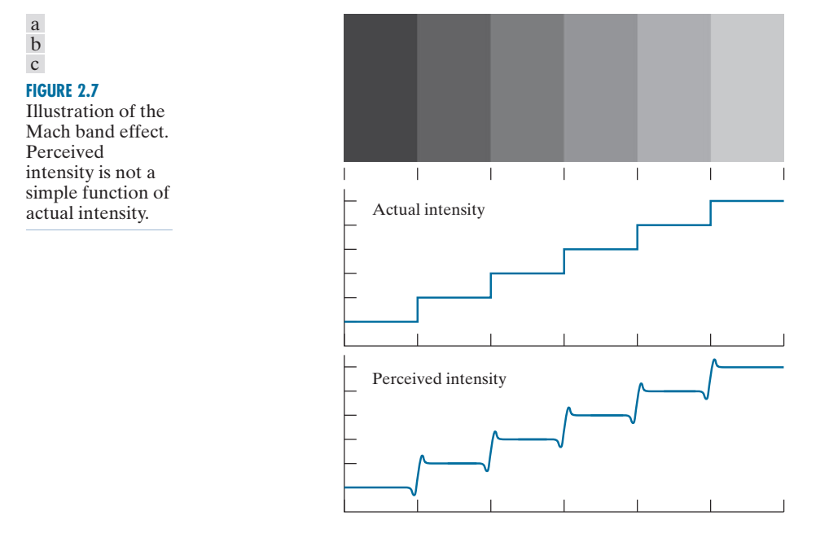
BRIGHTNESS ADAPTATION AND DISCRIMINATION
we actually perceive a brightness pattern that is strongly scalloped near the boundaries, as Fig. 2.7(c) shows. These perceived scalloped bands are called Mach bands after Ernst Mach, who first described the phenomenon in 1865.

Slide 3
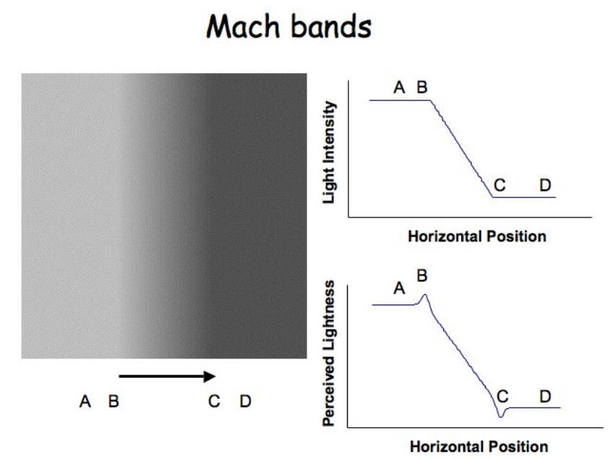

Slide 4
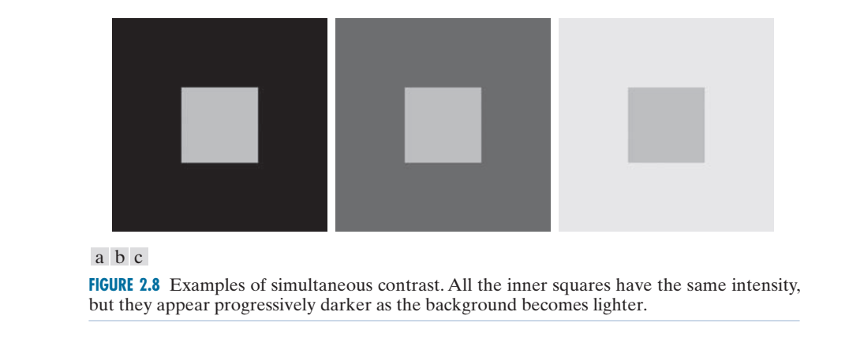
BRIGHTNESS ADAPTATION AND DISCRIMINATION
simultaneous contrast, is that a region’s perceived brightness does not depend only on its intensity, as Fig. 2.8 demonstrates. All the center squares have exactly the same intensity, but each appears to the eye to become darker as the background gets lighter. A more familiar example is a piece of paper that looks white when lying on a desk, but can appear totally black when used to shield the eyes while looking directly at a bright sky.

Slide 5
A SIMPLE IMAGE FORMATION MODEL
we denote images by two-dimensional functions of the form f (x, y ). The value of f at spatial coordinates (x, y ) is a scalar quantity whose physical meaning is determined by the source of the image, and whose values are proportional to energy radiated by a physical source (e.g., electromagnetic waves).
As a consequence, f (x, y ) must be nonnegative† and finite; that is,
0 ≤ f (x , y) < ∞

Slide 6
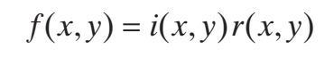
A SIMPLE IMAGE FORMATION MODEL
Function f (x, y ) is characterized by two components: (1) the amount of source illumination incident on the scene being viewed, and (2) the amount of illumination reflected by the objects in the scene. Appropriately, these are called the illumination and reflectance components, and are denoted by i (x, y ) and r (x, y ), respectively. The two functions combine as a product to form f (x, y ):
0 ≤ i (x, y) < ∞
0 ≤ r (x, y) ≤ 1
Thus, reflectance is bounded by 0 (total absorption) and 1 (total reflectance). The nature of i (x, y ) is determined by the illumination source, and r (x, y ) is determined by the characteristics of the imaged objects.
The objects which shine due the light of other objects are called illuminated objects. Example: Earth's moon, receives light from the sun and reflects it.

Slide 7
A SIMPLE IMAGE FORMATION MODEL
The following numerical quantities illustrate some typical values of illumination and reflectance for visible light. On a clear day, the sun may produce in excess of 90 000, lm/m^2 of illumination on the surface of the earth. This value decreases to less than 10 000, lm/m^2 on a cloudy day. On a clear evening, a full moon yields about 0 .1 lm/m^2 of illumination. The typical illumination level in a commercial office is about 1 000, lm/m^2. Similarly, the following are typical values of r (x, y ): 0.01 for black velvet, 0.65 for stainless steel, 0.80 for flat-white wall paint, 0.90 for silver-plated metal, and 0.93 for snow.

Slide 8
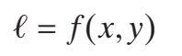
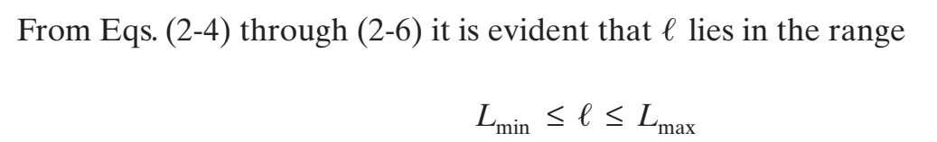
A SIMPLE IMAGE FORMATION MODEL
Let the intensity (gray level) of a monochrome image at any coordinates (x, y ) be denoted by

Slide 9
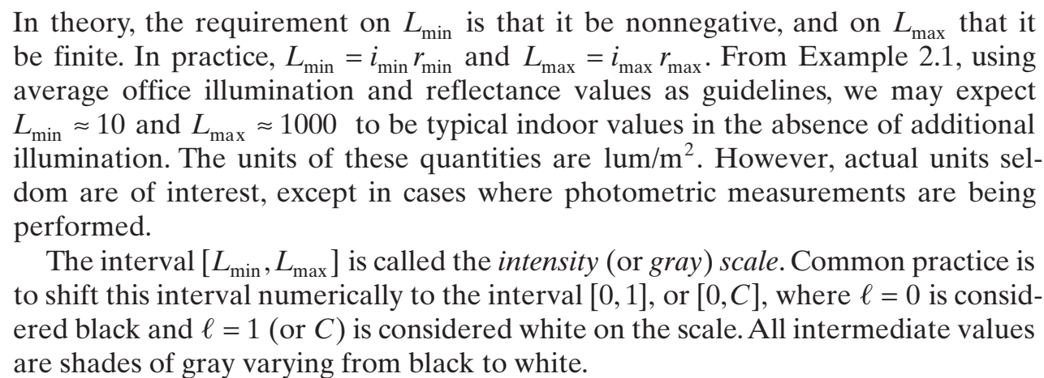
A SIMPLE IMAGE FORMATION MODEL

Slide 10
SAMPLING AND QUANTIZATION
To convert the continuous function f(x,y) to digital form we need to sample the continuous sensed data in both coordinates and in amplitude using finite and discrete sets of values.
Digitizing the coordinate values is called sampling.
Digitizing the amplitude values is called quantization.
The number of selected values in the sampling process is known as the image spatial resolution. This is simply the number of pixels relative to the given image area
The number of selected values in the quantization process is called the grey-level (color level) resolution. This is expressed in terms of the number of bits allocated to the color levels.
The quality of a digitized image depends on the resolution parameters of both processes.

Slide 11
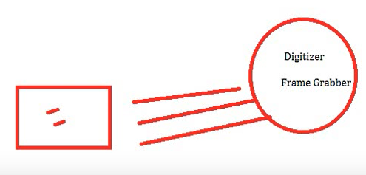
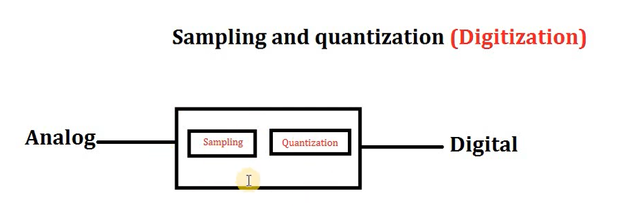
SAMPLING AND QUANTIZATION
Digitizer in camera do sampling and quantization.
An image have coordinates and intensity (color).

Slide 12
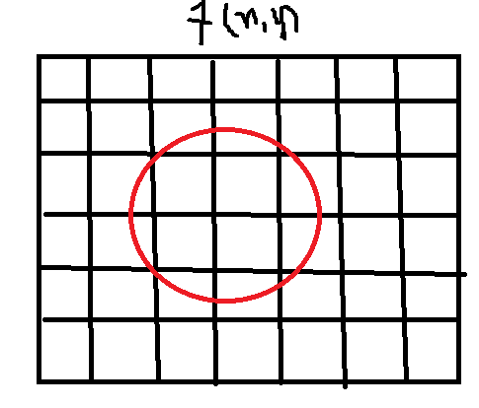
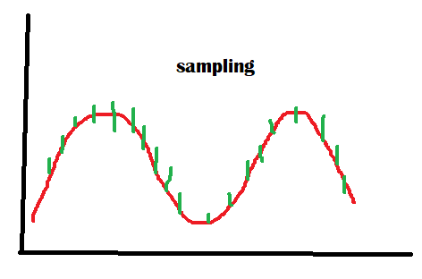
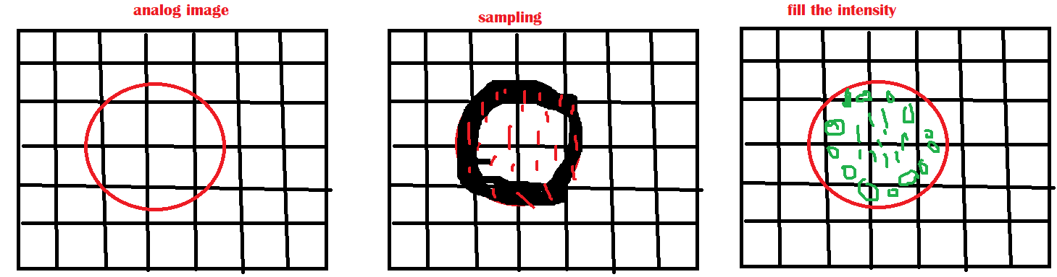
Sampling and quantization

Slide 13
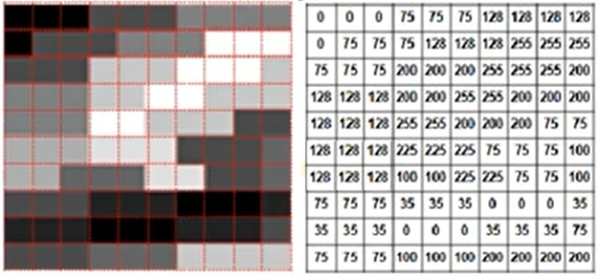
Sampling and quantization

Slide 14
SAMPLING AND QUANTIZATION
We can capture a picture using the sensors in imaging tools, such as a camera. The sensors produce an image in the form of an analog signal, which is then digitized to produce a digital image.
A digital image is a two-dimensional function f(x,y) where x and y indicate the position in an image. The f(x,y) function holds a discrete value called the intensity value.

Slide 15
SAMPLING AND QUANTIZATION
A digital image f(x,y) consists of coordinates x and y. Additionally, it contains the function’s amplitude. Quantization refers to digitizing the amplitudes, while sampling refers to digitizing the coordinate values.
The sensors placed in the image acquisition device capture the projected continuous image. Later, this digitizes to form a digital image suitable for real-time applications. For example, let’s see the difference between a continuous and digital image:

Slide 16
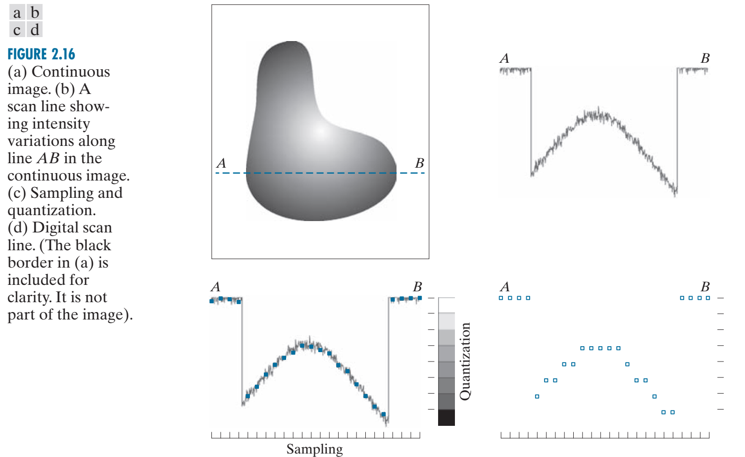
SAMPLING AND QUANTIZATION

Slide 17
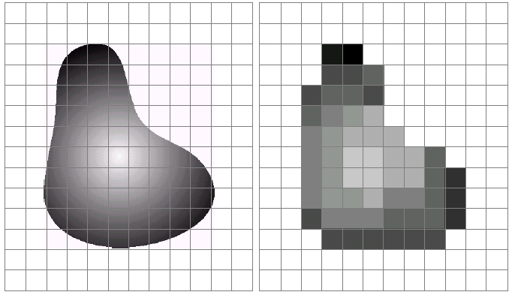
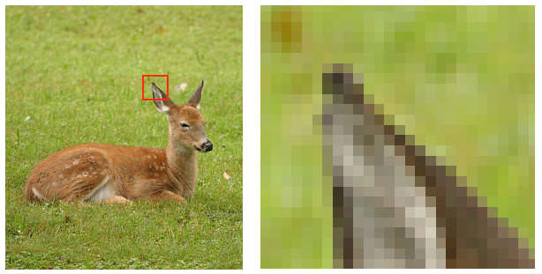
SAMPLING AND QUANTIZATION
Pixel values typically represent gray levels, colors, heights, etc
Remember digitization implies that a digital image is an approximation of a real scene
1 pixel

Slide 18
Digital image Representation – Revised
A monochrome digital image is a 2-dimensional light intensity function f (x,y) whose independent variables (x,y) are digitized through spatial sampling, and whose intensity values are quantized by a finite uniformly spread grey-levels. i.e. an image f can be represented as a 2-dimensional array:
f(1,1) f(1,2) f(1,3) … f(1,n)
f(2,1) f(2,2) f(2,3) … f(2,n)
f = f(3,1) f(3,2) f(3,3) … f(3,n)
: : : : :
: : : : :
f(m,1) f(m,2) f(m,3) … f(m,n)
Usually, m=n and the number of gray levels are g=2^{k} for some k. The spatial resolution is mn and g is the grey level resolution.
RGB-based color images are represented similarly except that f(i,j) is a 3D vector representing intensity of the three primary colors at the (i,j) pixel position,

Slide 19
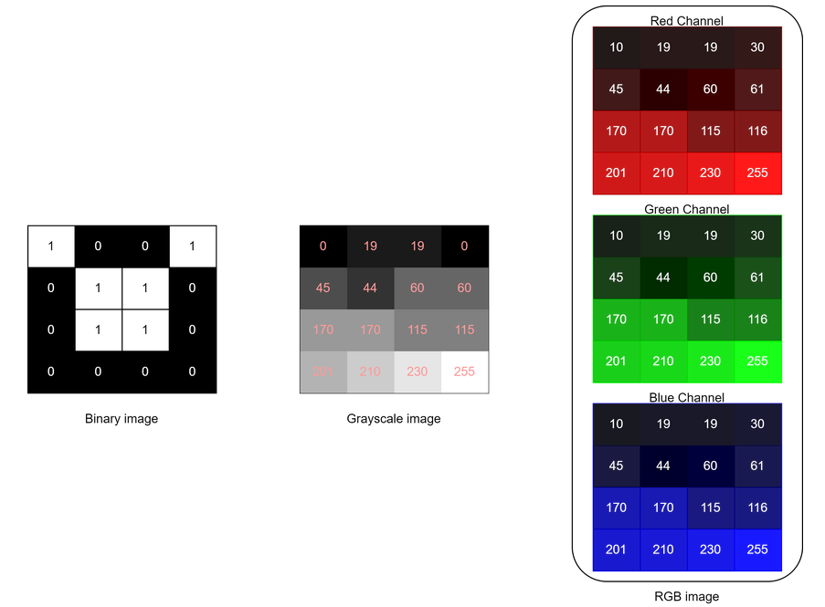
Digital Images
Digital images are basically of three types: monochrome or binary images, grayscale images, and color images.
The pixel value of a binary image at a specific location (x,y) usually holds the value 0 for black or 1 for white. Grayscale images have intensity values ranging from 0 to 255, where 0 is black, gradually fading to 255, which is white. Additionally, color images like RGB images contain three channels red, green, and blue channels. Each channel in an RGB image has intensity values ranging from 0-255.

Slide 20
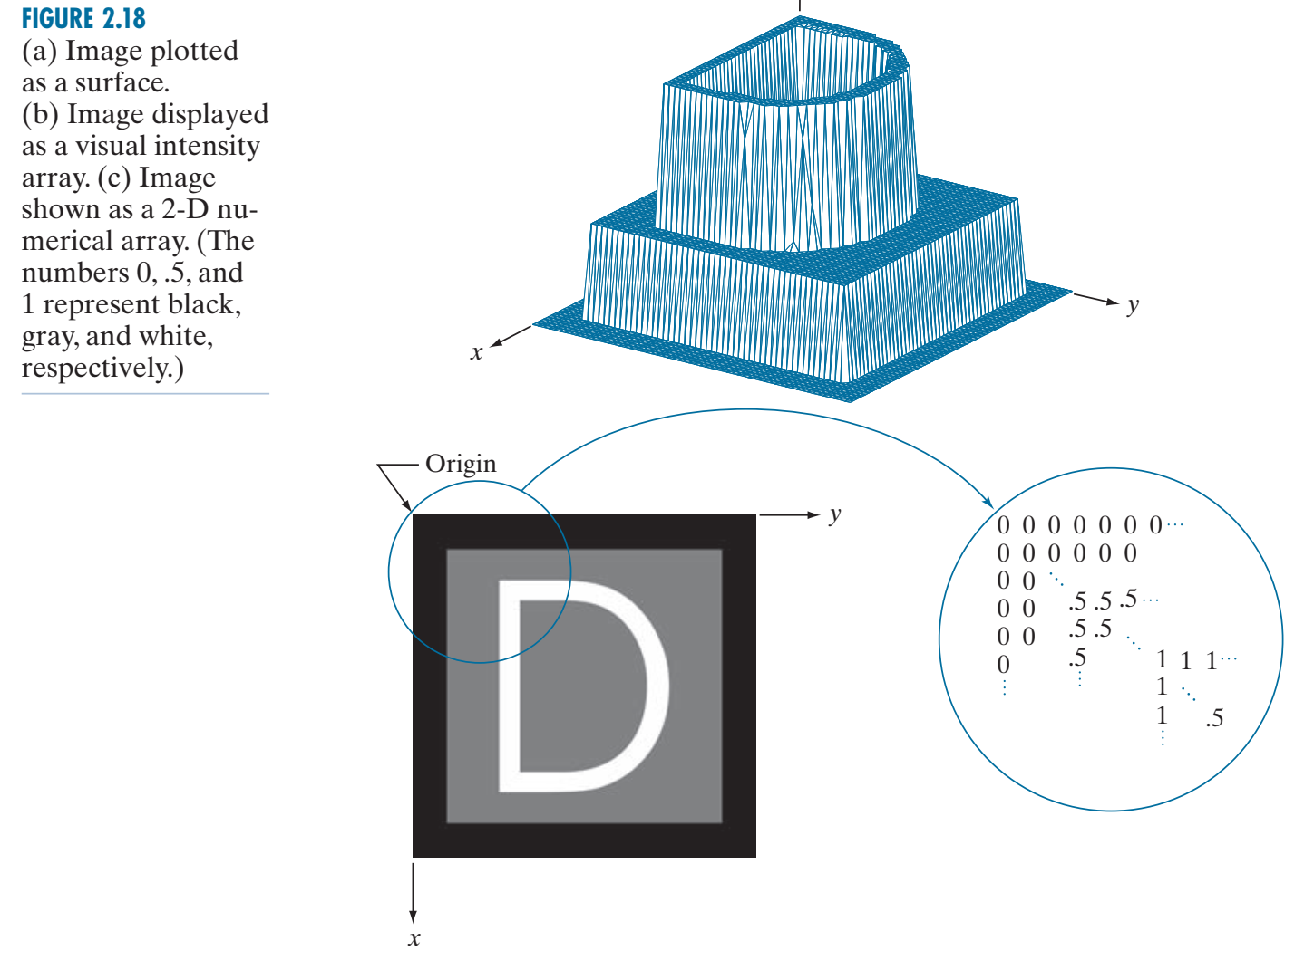
REPRESENTING DIGITAL IMAGES

Slide 21
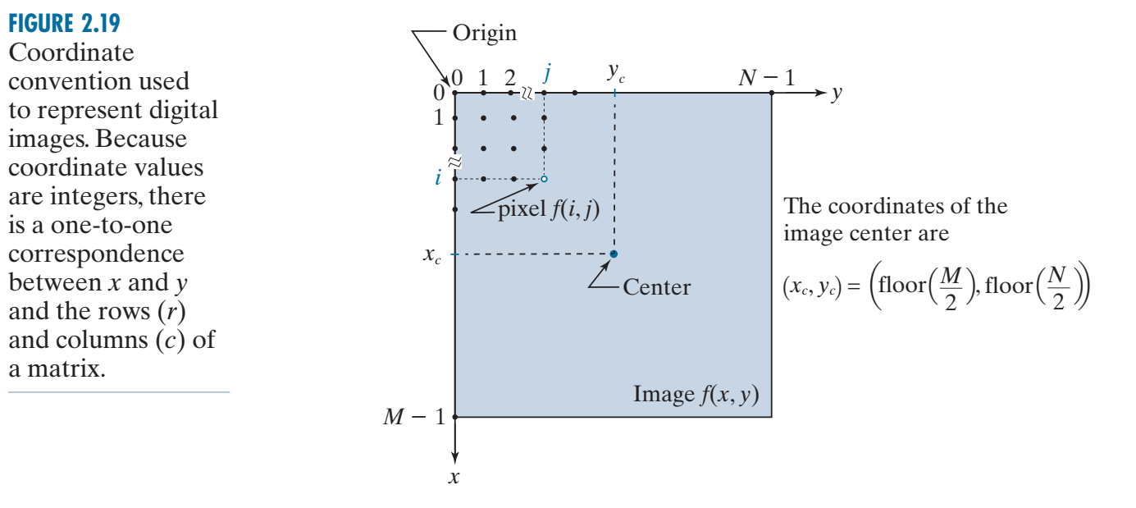
REPRESENTING DIGITAL IMAGES

Slide 22
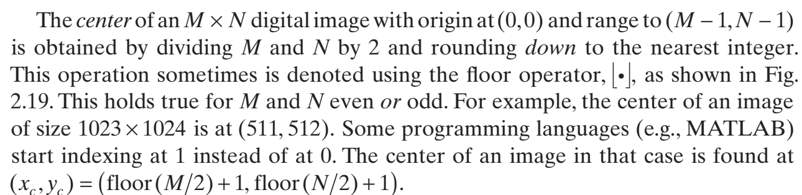
REPRESENTING DIGITAL IMAGES

Slide 23
Spatial Resolution
The spatial resolution of a digital image reflects the amount of details that one can see in the image (i.e. the ratio of pixel “area” to the area of the image display).
If an image is spatially sampled at mxn pixels, then the larger mn the finer the observed details.
For a fixed image area, the noticeable image quality is directly proportional to the value of mn results.
Reduced spatial resolution, within the same area, may result in what is known as Checkerboard pattern.
However beyond a certain fine spatial resolution, the human eye may not be able to notice improved quality.

Slide 24
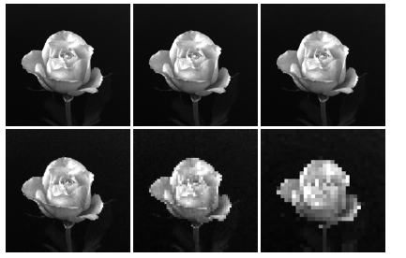
Spatial Resolution Vs Image Quality
Decreasing spatial resolution reduces image quality proportionally - Checkerboard pattern.
† Images extracted from DIP, 2nd Edition, Gonzalez & Woods, PH.

Slide 25
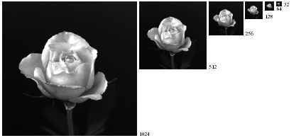
Spatial Resolution Vs Image Quality - continued
The checkerboard effect is not visible if a lower–resolution image is displayed in a proportionately small window.

Slide 26
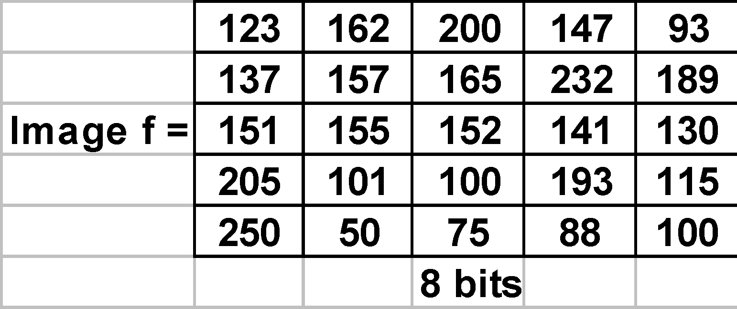
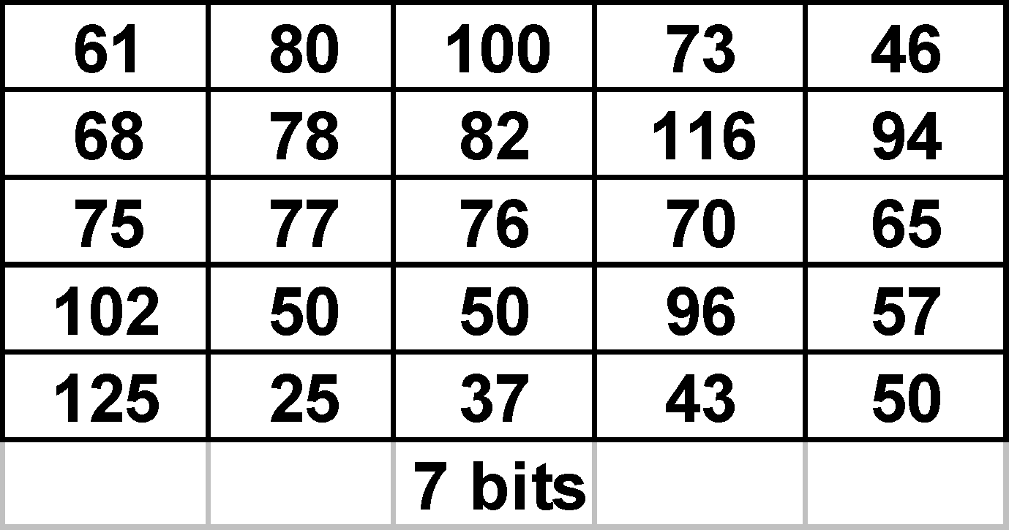
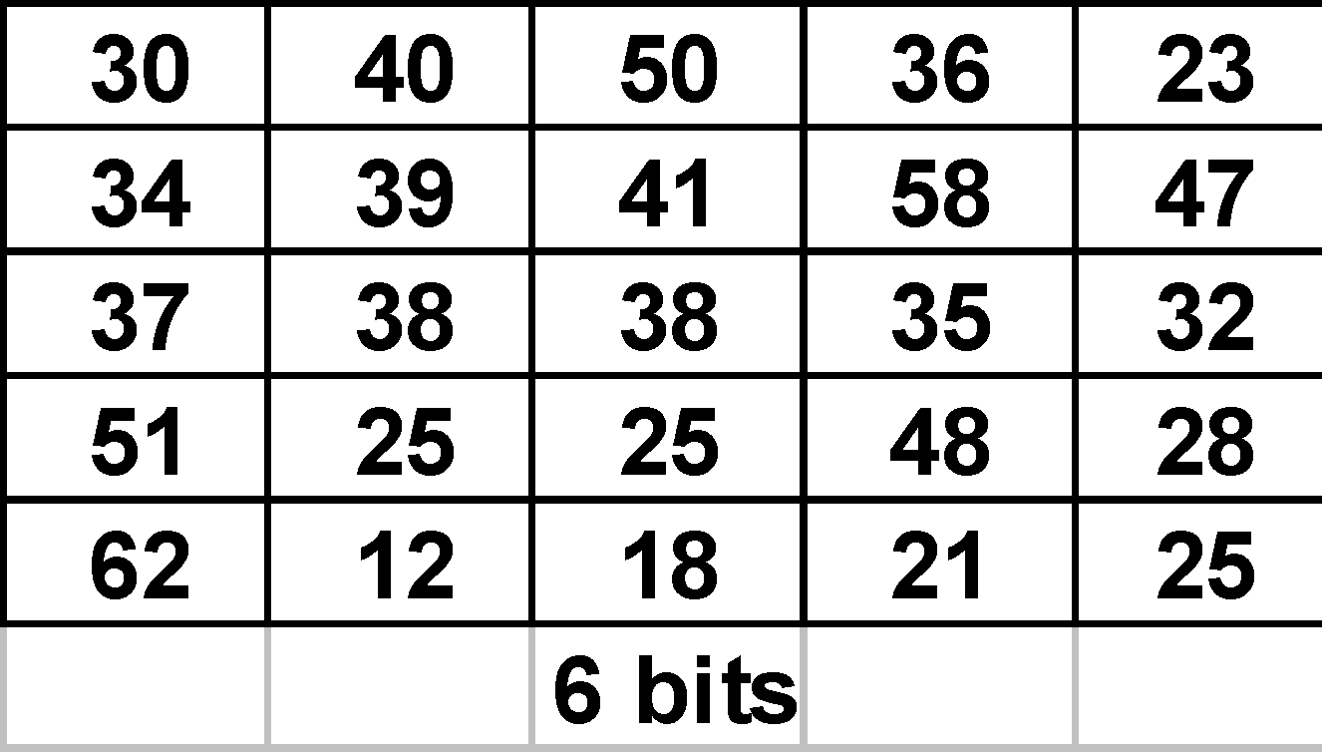
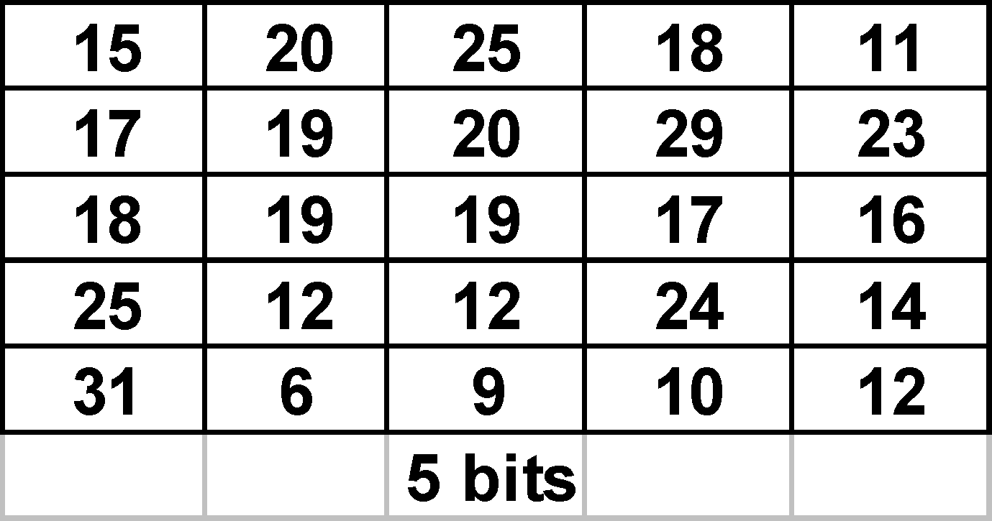
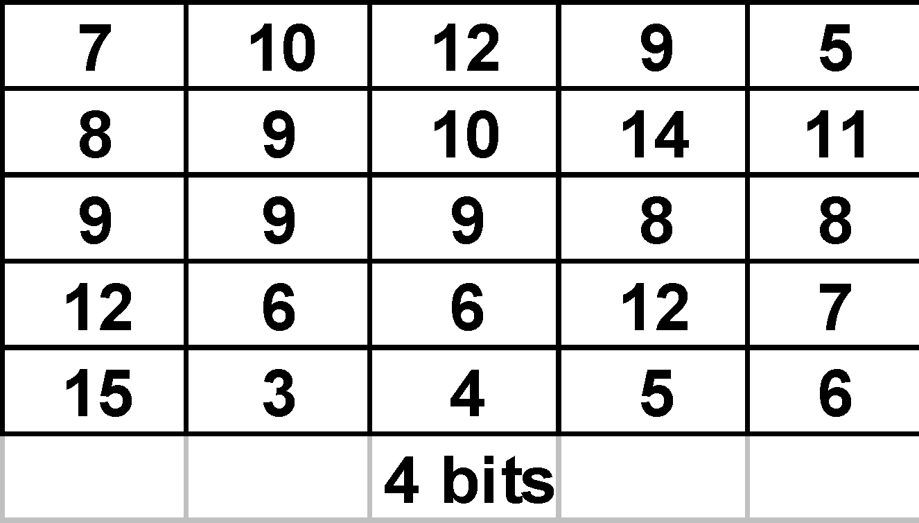
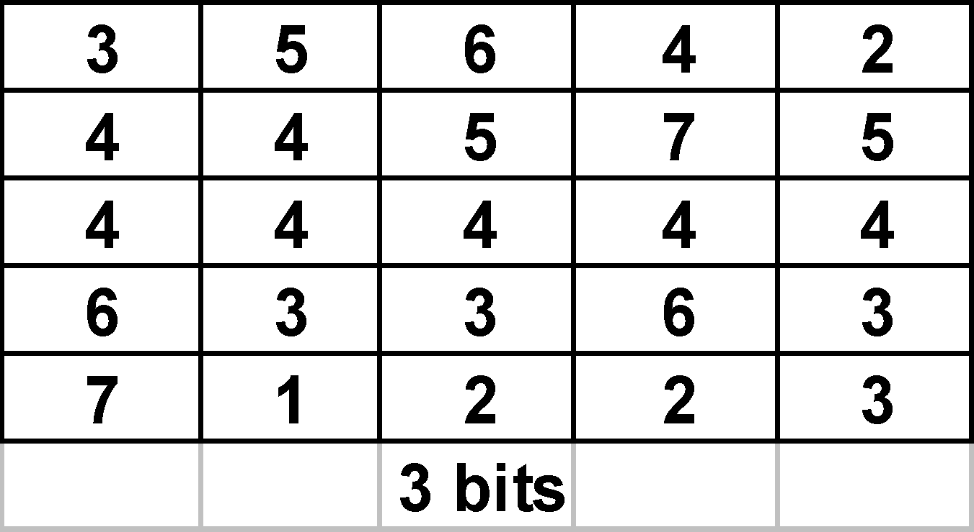
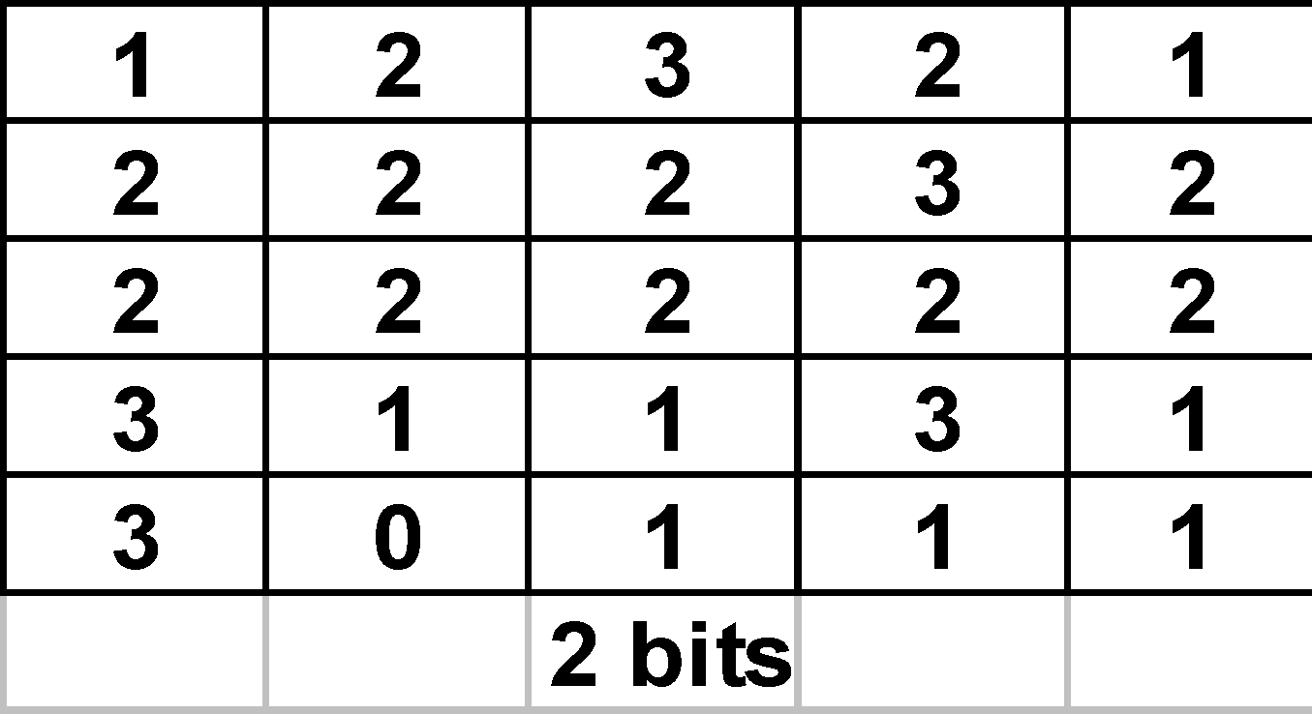
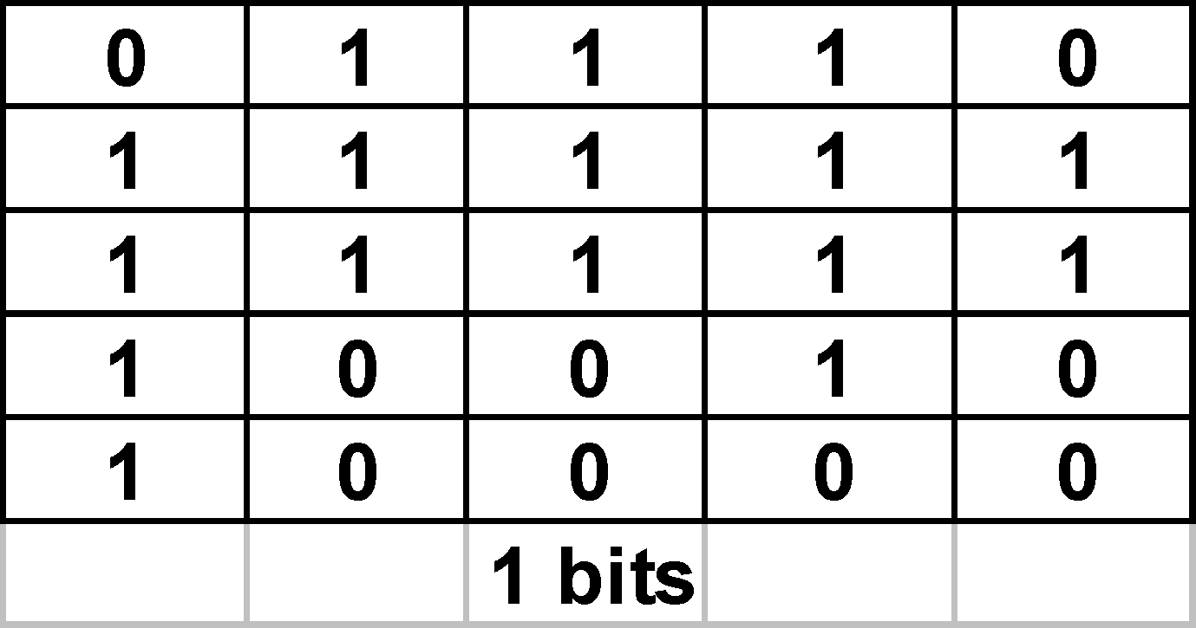
Effect of grey level resolution
f(i,j)← int(f(i,j)/2)
Original image f is reasonably bright, but gradually the pixels get darker as the Grey-level resolution decreases.

Slide 27

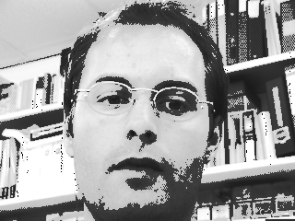


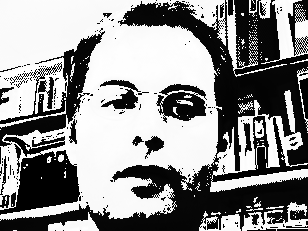
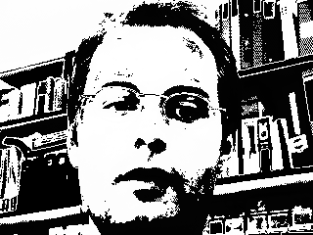
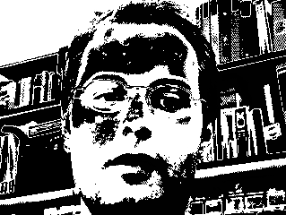
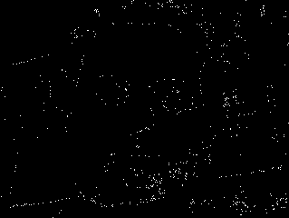

Effect of grey level resolution
8 bits
7 bits
6 bits
5 bits
4 bits
3 bits
2 bits
1 bit
0 bits !!!

Slide 28
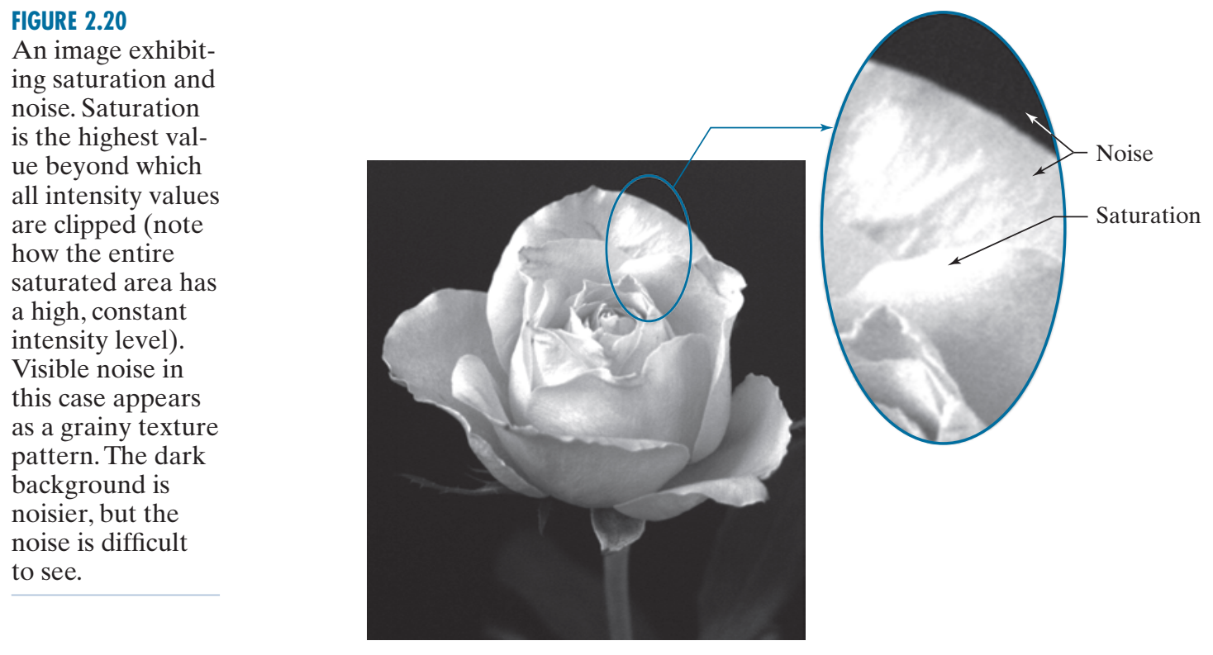
Sometimes, the range of values spanned by the grayscale is referred to as the dynamic range, a term used in different ways in different fields. Here, we define the dynamic range of an imaging system to be the ratio of the maximum measurable intensity to the minimum detectable intensity level in the system. As a rule, the upper limit is determined by saturation and the lower limit by noise, although noise can be present also in lighter intensities.

Slide 29
REPRESENTING DIGITAL IMAGES
The number, b, of bits required to store a digital image is
b = M * N * K
When M = N
B = N^2 * k

Slide 30
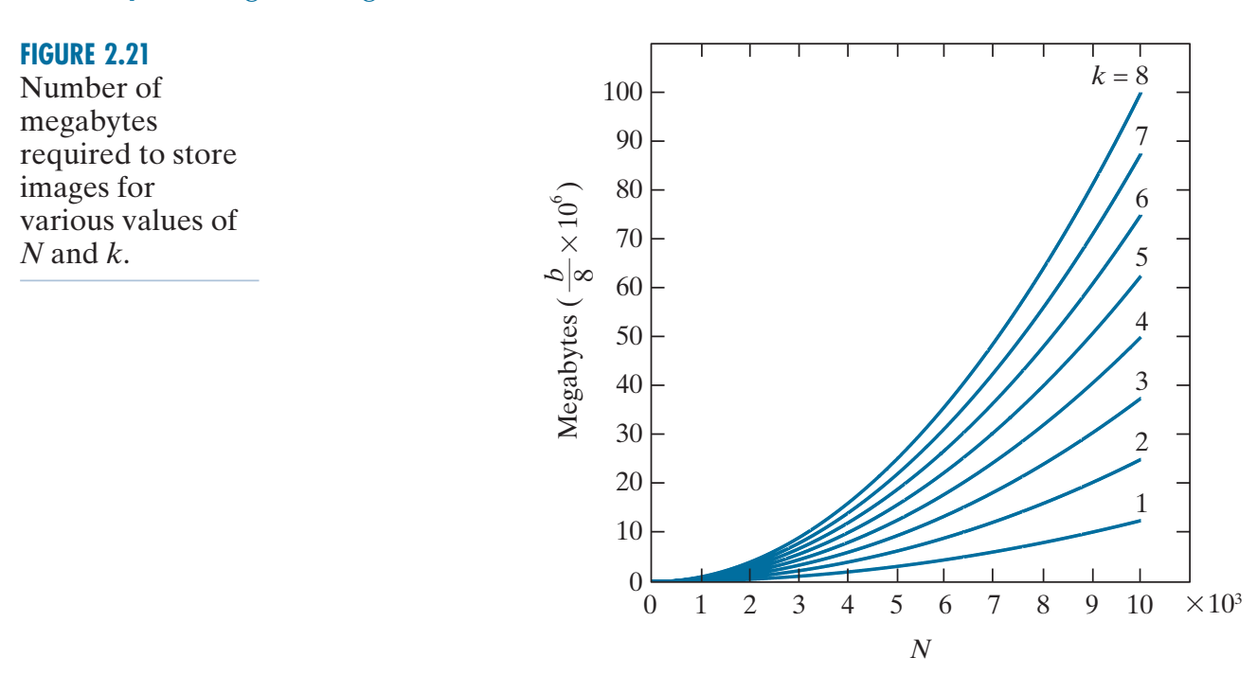
Image storage

Slide 31
The size of a digital image file depends on its resolution, color depth, and file format.
Given that the image has a resolution of m = 1000 x n = 1000 pixels and a color depth of k = 8 bits per pixel (bpp), we can calculate the size of the image as follows:
Number of pixels = m x n = 1000 x 1000 = 1,000,000 pixels
Size per pixel = k/8 bytes per pixel = 8/8 = 1 byte per pixel
Therefore, the size of the image file in bytes is:
Size in bytes = Number of pixels x Size per pixel = 1,000,000 x 1 = 1,000,000 bytes
To convert this to kilobytes (KB) and megabytes (MB), we can use the following conversion factors:
1 KB = 1024 bytes
1 MB = 1024 KB
So, the size of the image file in kilobytes and megabytes is:
Size in KB = Size in bytes / 1024 = 1,000,000 / 1024 = 976.5625 KB (approx.)
Size in MB = Size in KB / 1024 = 976.5625 / 1024 = 0.95367 MB (approx.)
Therefore, to store this digital image, we would need approximately 1,000,000 bytes, 976.5625 KB or 0.95367 MB of storage space.

Slide 32
SPATIAL AND INTENSITY RESOLUTION
Intuitively, spatial resolution is a measure of the smallest discernible detail in an image. Quantitatively, spatial resolution can be stated in several ways, with line pairs per unit distance, and dots (pixels) per unit distance being common measures. Suppose that we construct a chart with alternating black and white vertical lines, each of width W units (W can be less than 1). The width of a line pair is thus 2W, and there are W 2 line pairs per unit distance. For example, if the width of a line is 0.1 mm, there are 5 line pairs per unit distance (i.e., per mm). A widely used definition of image resolution is the largest number of discernible line pairs per unit distance (e.g., 100 line pairs per mm). Dots per unit distance is a measure of image resolution used in the printing and publishing industry. In the U.S., this measure usually is expressed as dots per inch (dpi).

Slide 33
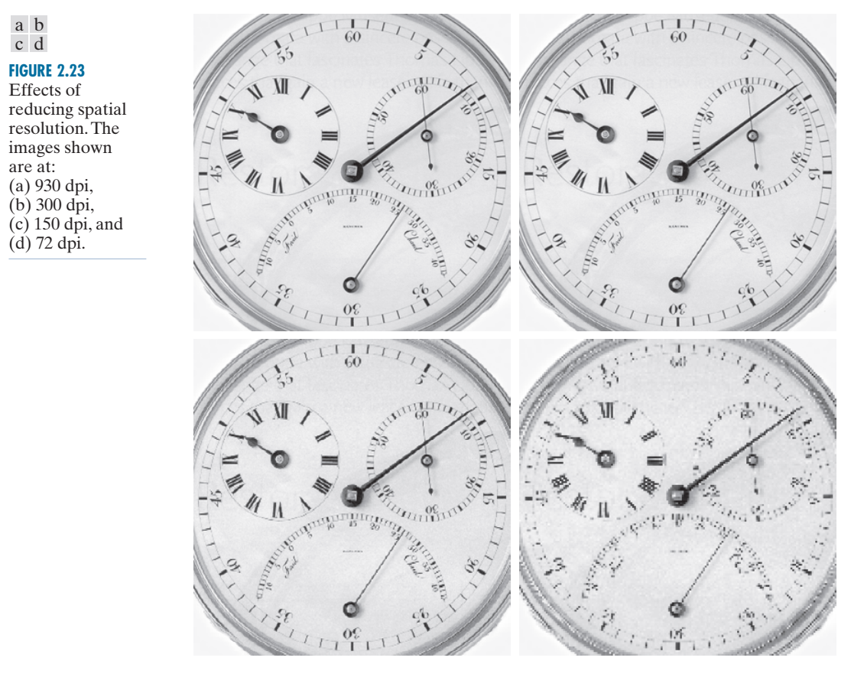
SPATIAL AND INTENSITY RESOLUTION
DPI stands for Dots per Inch, referring to the number of ink droplets a printer will produce per inch while printing an image. The more dots of ink per inch the picture has, the more detail you will see when printed.

Slide 34
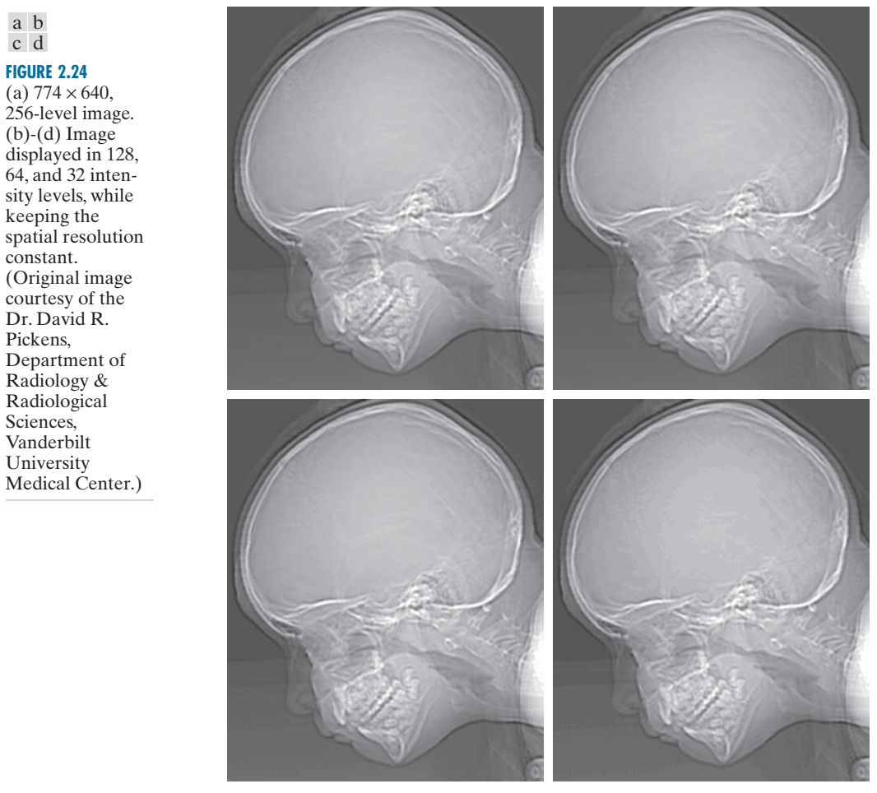
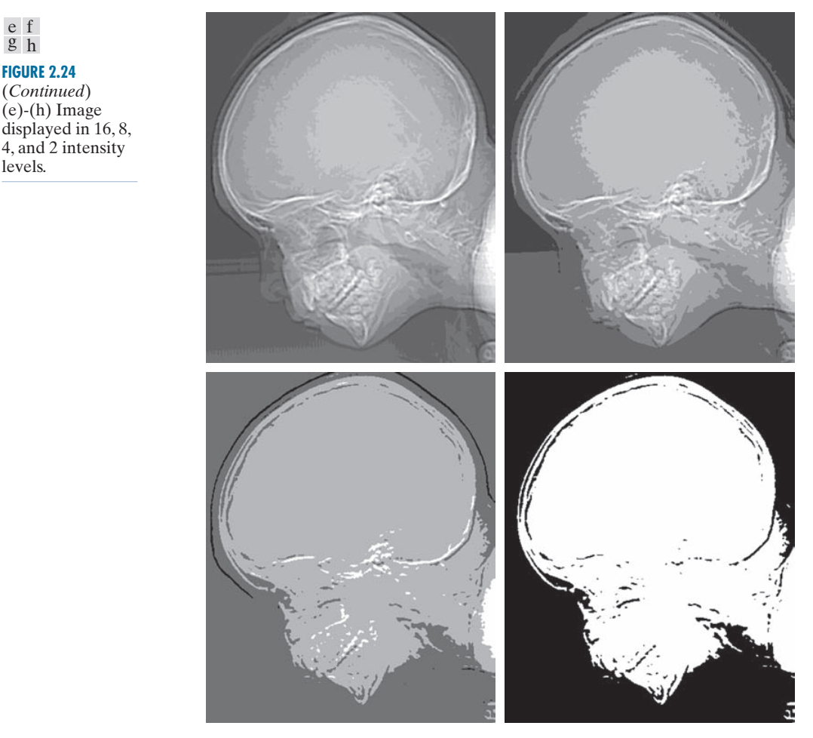
SPATIAL AND INTENSITY RESOLUTION

Slide 35
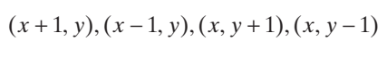

SOME BASIC RELATIONSHIPS BETWEEN PIXELS
A pixel p at coordinates (x, y ) has two horizontal and two vertical neighbors with coordinates.
This set of pixels, called the 4-neighbors of p, is denoted N 4(p ). The four diagonal neighbors of p have coordinates
and are denoted N D(p). These neighbors, together with the 4-neighbors, are called the 8-neighbors of p, denoted by N 8(p). The set of image locations of the neighbors of a point p is called the neighborhood of p. The neighborhood is said to be closed if it contains p. Otherwise, the neighborhood is said to be open.

Slide 36
ADJACENCY, CONNECTIVITY, REGIONS, AND BOUNDARIES
Let V be the set of intensity values used to define adjacency. In a binary image, V = {1 } if we are referring to adjacency of pixels with value 1. In a grayscale image, the idea is the same, but set V typically contains more elements. For example, if we are dealing with the adjacency of pixels whose values are in the range 0 to 255, set V could be any subset of these 256 values. We consider three types of adjacency:
1. 4-adjacency. Two pixels p and q with values from V are 4-adjacent if q is in the set N 4(p ). 2. 8-adjacency. Two pixels p and q with values from V are 8-adjacent if q is in the set N 8(p). 3. m-adjacency (also called mixed adjacency). Two pixels p and q with values from V are m-adjacent if
(a) q is in N 4 (p), or (b) q is in N D (p ) and the set N 4 (p ) ∩ N 4 (q ) has no pixels whose values are from V.

